Slide 1
Word Lesson 8 Increasing Efficiency Using Word
Microsoft Office 2010 Introductory
Pasewark & Pasewark

Slide 2
Objectives
Use and create templates.
Use mail merge.
Create and print envelopes and labels.
Insert, view, edit, and print comments.
2
2

Slide 3
Objectives (continued)
Track changes.
Accept and reject changes and delete comments.
Combine different versions of a document.
Customize Word.
3
3

Slide 4
Vocabulary
data source
mail merge
main document
merge field
template
Track Changes
workgroup collaboration
4
4

Slide 5
Using Templates
A template is a file that contains the basic elements of a document, such as page and paragraph formatting, fonts, and text. You can customize the template.
Word contains many templates you can use to create documents. Some templates are installed on your computer, and others are available on the Microsoft Office Online Web site.
5
5

Slide 6
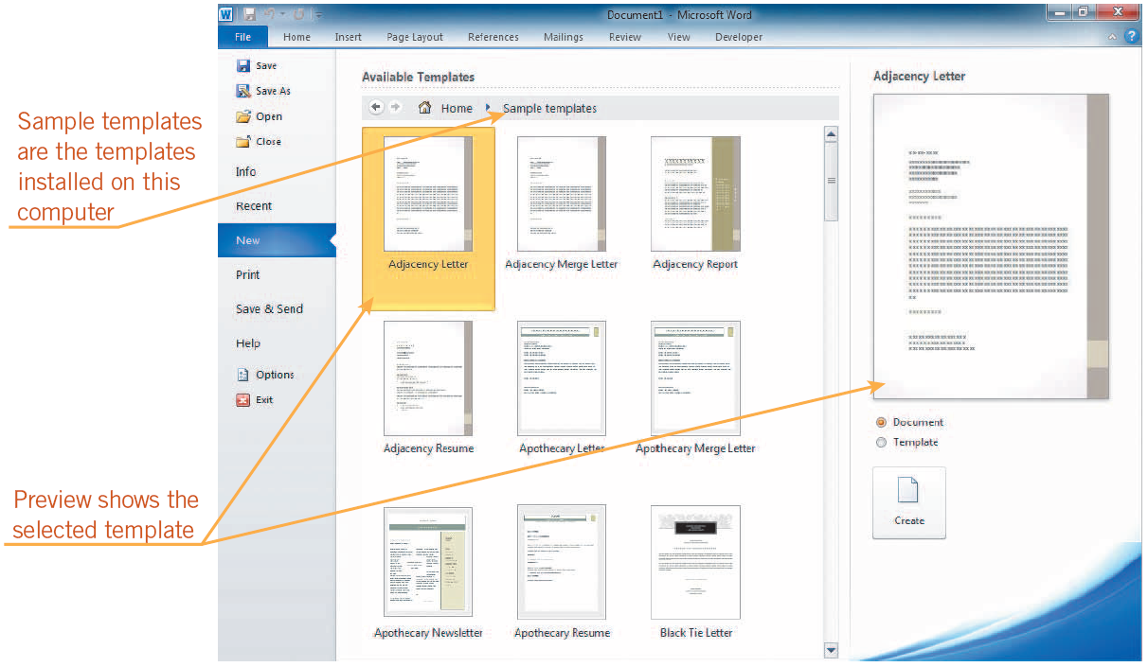
Using Templates (continued)
Sample templates on the New tab in Backstage view

Slide 7
Using Templates (continued)
You can create a customized template by modifying an existing template or document.
To create a template, you need to save the document as a template with a .dotx file extension.
You can use the template you created as many times as needed.
7
7

Slide 8
Using Mail Merge
Mail merge combines a document with information that personalizes the document.
The document with the information that does not change is called the main document.
The data source is the file containing the information that varies in each document.
Merge fields are placeholders that are replaced with data from the data source.
8
8

Slide 9
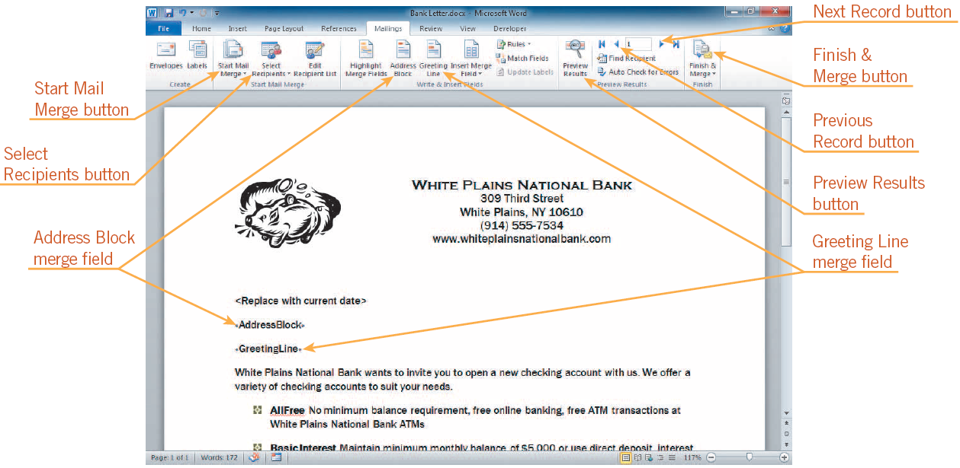
Using Mail Merge (continued)
Merge fields inserted using the Mailings tab on the Ribbon

Slide 10
Creating and Printing Envelopes
Addressing envelopes is easy using Word.
If you select an address before you open the Envelopes and Labels dialog box, the address appears in the Delivery address box in the dialog box.
To replace text in the Return address box, select it, and then type your own name and address.
10
10

Slide 11
Creating and Printing Labels
Creating labels is similar to creating envelopes.
The default is to print a full page of the same label. A Single Label option is also available.
The dimensions of the label are listed in the Label section.
11
11

Slide 12
Collaborating with a Workgroup Using Comments and Tracked Changes
The process of working together in teams, sharing comments, and exchanging ideas for a common purpose is called workgroup collaboration.
Word provides several ways team members can collaborate. Team members can circulate a document and add comments or changes to the document.
12
12

Slide 13
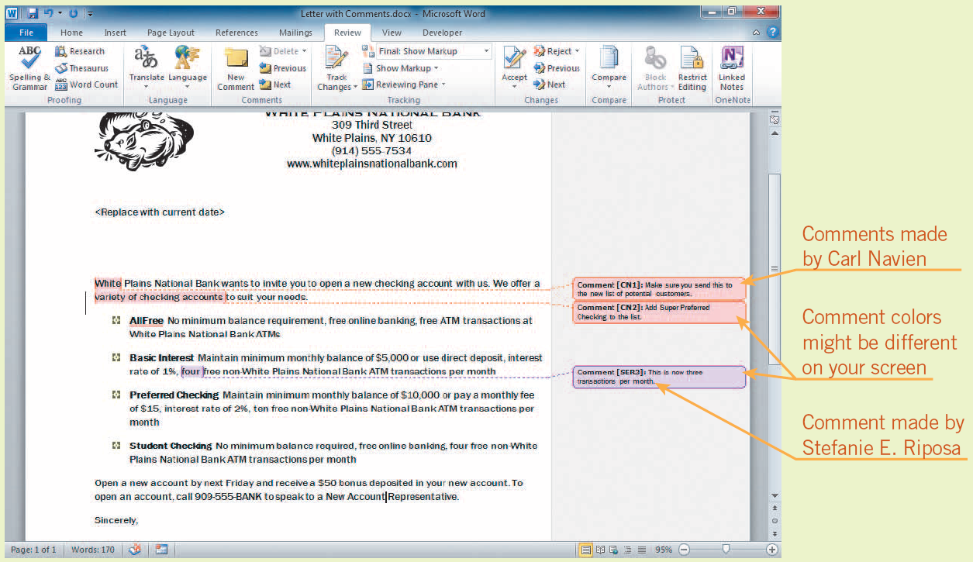
Collaborating with a Workgroup Using Comments and Tracked Changes (cont)
Document with comments from two people

Slide 14
Collaborating with a Workgroup Using Comments and Tracked Changes (cont)
When you make certain changes to a document, Word identifies the changes with the user name.
Each reviewers’ comments appear in a different color.
To move from comment to comment, click the Next or Previous button in the Comments group on the Review tab.
14
14

Slide 15
Collaborating with a Workgroup Using Comments and Tracked Changes (cont)
Word provides a tool called Track Changes that keeps a record of any changes you or a reviewer makes in a document.
You can accept or reject a change in the document.
You can print a document with comments and tracked changes.
15
15

Slide 16
Combine Different Versions of a Document
The Compare and Combine commands are useful ways to see differences between documents.
You should always look over the combined document carefully because the results might not be what you expect.
16
16

Slide 17
Customizing Word
You can customize many features of Word by using the Word Options dialog box.
- General options: Most common options for customizing Word, including the User name.
- Display options: Affects how the document looks on the screen and when printed.
You can customize the Ribbon and the Quick Access Toolbar.
17
17

Slide 18
Summary
In this lesson, you learned:
Templates allow you to save the format, font choices, and text of commonly produced documents. You can use installed templates, templates available on Microsoft Office Online, or you can create your own.
Mail merge lets you insert changing information into a standard document.
You can quickly create envelopes and labels in Word.
18
18

Slide 19
Summary (continued)
When working in a group, suggesting changes to a document is easily done by inserting comments, which are labeled with the person’s name and the date and time the comment was made.
Changes made by each person can be identified and labeled by using the Track Changes feature.
You can accept or reject tracked changes and delete comments.
19
19

Slide 20
Summary (continued)
You can print a document with tracked changes and comments, or you can print the document without the comments and as if all the tracked changes were accepted.
You can combine documents with comments and changes into one document for easy review.
You can customize Word by changing the options in the Word Options dialog box.
20
20

